Slide 1
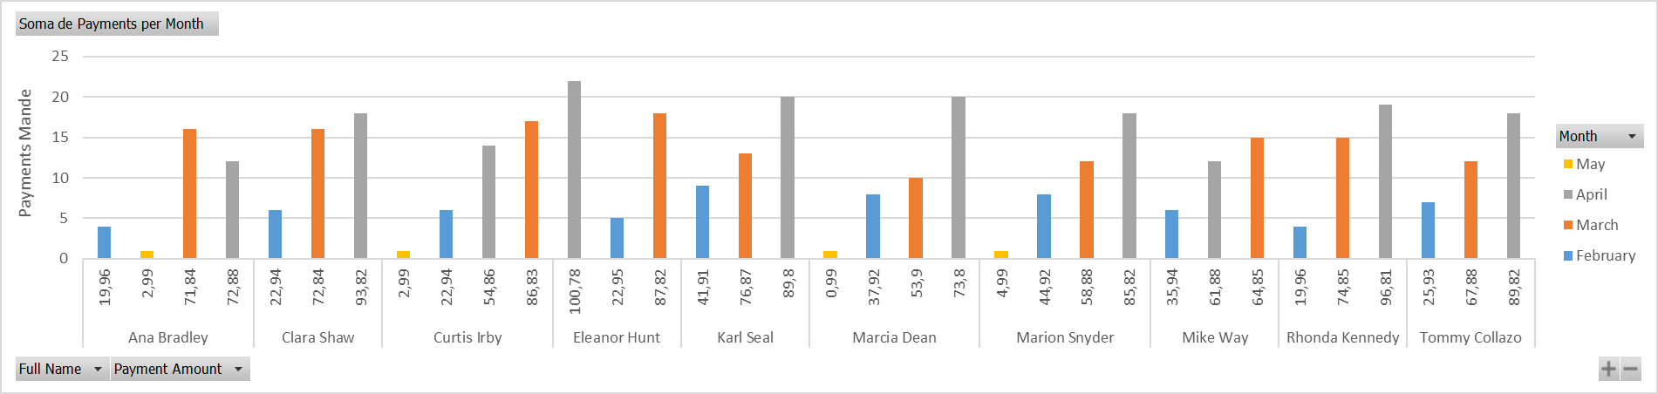
Top 10 paying customers and their monthly payments.
Query #2 – Top 10 Customers and their monthly payments
<visualization>
In this graph, we can see the top 10 customers, their monthly expenses and the number of payments made during 2007.

Slide 2
The number of movie rentals by genre and their average.
Query #2 – Movie Rentals by Genre
<visualization>
This bar shows the total number of rentals made by the movie genre and compares the rental average among genres.

Slide 3
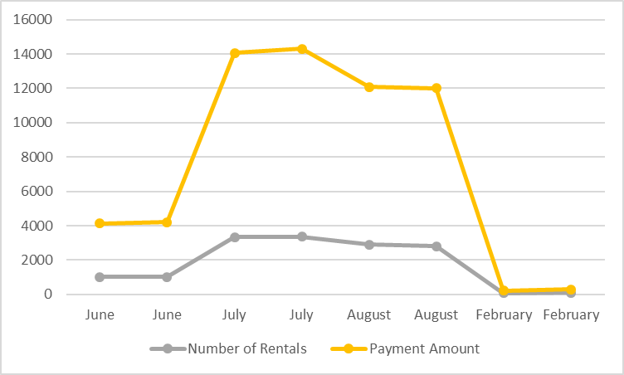
The performance (payment amount and number of rentals) of Sakila DVD Rental database
Query #3 – Sakila Performance
<visualization>
In this chart, we can see Sakila’s business performance according to the total payment amount as well as the total rentals made (during 2005 – 2006).

Slide 4
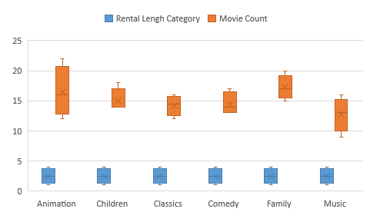
A list of family-friendly film category, rental length category, and the corresponding count of movies within each combination of film category.
Query #4 - Film rentals distribution by category
This box and whisker chart shows how the number of family-friendly movies is distributed according to rental length duration and movie category.

